Slide 1

VSkin: Sensing Touch Gestures on Surfaces of Mobile Devices Using Acoustic Signals
Ke Sun, Ting Zhao, Wei Wang, and Lei Xie
State Key Laboratory for Novel Software Technology
Nanjing University
MobiCom'18 Nov 1st, 2018

Slide 2
Motivation
Touchscreen gestures: de facto standard user interface
Only on the touchscreen!

Slide 3
Motivation
Occlusion problems !

Slide 4
Motivation
Click or Scroll?
User intentions confusion!

Slide 5
Motivation
Too many buttons
on the screen
Bad experience!

Slide 6
If we can enable the touch gestures on all surfaces of the mobile devices?

Slide 7
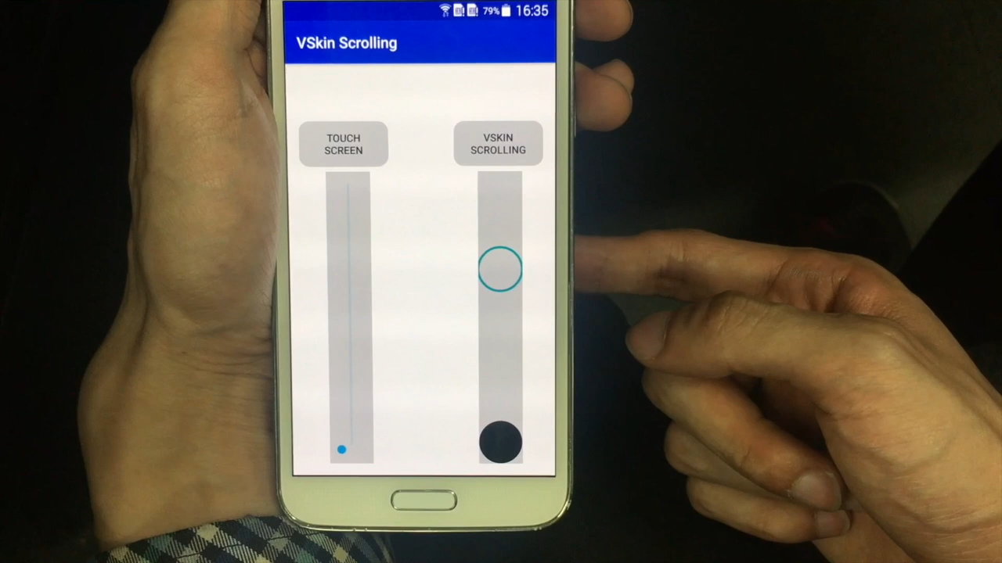

Slide 8
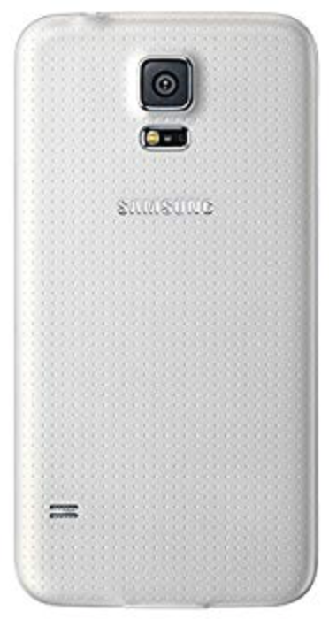
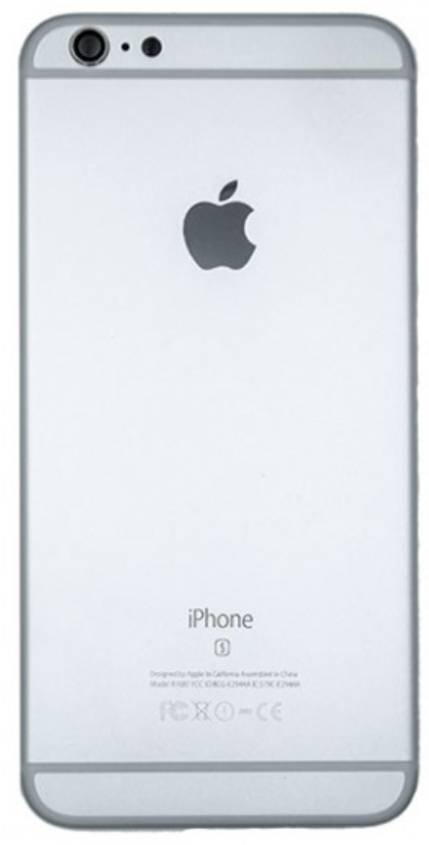
Basic idea
Mic
Mic
VSkin utilizes the built-in speakers
and microphones to send and receive ultrasound signals for touch-sensing.
Speaker
Mic
Mic
Speaker

Slide 9
Basic idea
Structure-borne sound
LOS air sound
Reflection air sound

Slide 10
Basic idea
When performing touch gestures:
Structure sound pattern changes:
Touch detection
Reflection air path distance changes:
Movement measurement

Slide 11
Challenge 1
How to separate the structure-borne and the air-borne sound signals?

Slide 12
Basic idea: Delay difference
Structure-borne sound
High speed
Low delay
LOS air sound
Low speed
Medium delay
Reflection air sound
Long distance
Large delay

Slide 13

Basic idea: Delay difference
Too small interval
to hear the echo
Structure sound
LOS sound
Reflect sound
Challenge: Delay difference is too small (<0.34 ms) !
Solution: Transmission signal design
Notes:
5A

Slide 14
Transmission signal design
Choose ‘explicit’ signal
High resolution
High SNR
Narrow inaudible range
Phase information
ZC sequence

Slide 15
Transmission signal design
ZC sequence: near-optimal auto-correlation function
Narrow main lobe width
High gain
Low side lobe
Autocorrelation of baseband ZC sequence

Slide 16
Sound Propagation Separation
Mixed !
Structure sound
LOS sound
Use cross-correlation to estimate impulse response
Reflect sound
Peaks indicate propagation paths

Slide 17
Sound Propagation Separation
Structure-borne sound
LOS air sound
Bottom Mic
Reflection air sound
Top Mic

Slide 18
Sound Propagation Separation
Static delay:
Structure-borne path
LOS air path
Calibration
Dynamic delay:
Reflection air path
Dynamic change
Bottom Mic
Top Mic

Slide 19
Challenge 2
How to measure the path coefficient (phase & amplitude) of single path?
Notes:
科普

Slide 20
Path coefficient
Path coefficient: I/Q trace for certain delay
I/Q trace → Phase & amplitude
Phase change: path distance
Amplitude: path strength

Slide 21
Challenge 2
Tradition: One frame obtains one result for signal path.
Path coefficient sampling rate is not enough when moving fast!
I/Q trace when moving the hand

Slide 22
Basic idea: Moving window
ZC sequence
ZC sequence
ZC sequence
ZC sequence
Receive sequence
Receive sequence
Receive sequence
Receive sequence
1
2
3
4
Only 1 result for 1 frame！

Slide 23
Basic idea: Moving window
ZC sequence
ZC sequence
ZC sequence
ZC sequence
Receive sequence
Receive sequence
Receive sequence
Receive sequence
...
1
2
3
High sampling rate！

Slide 24
Challenge 3
How to measure the movement and detect the touch?

Slide 25
Movement measurement
Reflect path delay changes when moving
Notes:
原因

Slide 26
Movement measurement
Select the delay of reflection path based on differential IR
Move away
Move towards
Magnitude of differential IR estimations
Notes:
原因

Slide 27
Movement measurement
Additive Noise Mitigation:
Extended Kalman Filter
Phase Based Measurement:
Curvature-based estimation

Slide 28
Touch detection
Unique patterns for different positions
Touch
Release
Touch
Release
Magnitude of differential IR estimations
at 1 cm away from speaker
Magnitude of differential IR estimations at 7 cm away from speaker
Delay of the peak in differential IR estimation to determine the touch position
Notes:
加图

Slide 29
Implementation
Mic
Real-time APP works on COTS mobile phone:
Use rear speaker, top microphone, and bottom microphone
Enable touch gestures, e.g., scrolling, swiping, and tapping
Conduct on four different kinds of smartphones
Speaker
Mic

Slide 30
Finger movement accuracy
Average movement distance error of 3.59 mm
Movement distance with speeds from 2 cm/s to 12 cm/s

Slide 31

Finger movement robustness
Jamming distance
Robust for different diameters and holding styles
Robust to other interfering movements
Robust to background audible acoustic noises

Slide 32
Touch measurement accuracy
Touch detection rate of 98% at the back of the phone
Average accuracy of 87.82% for classifying touches to three different regions of the phone.

Slide 33
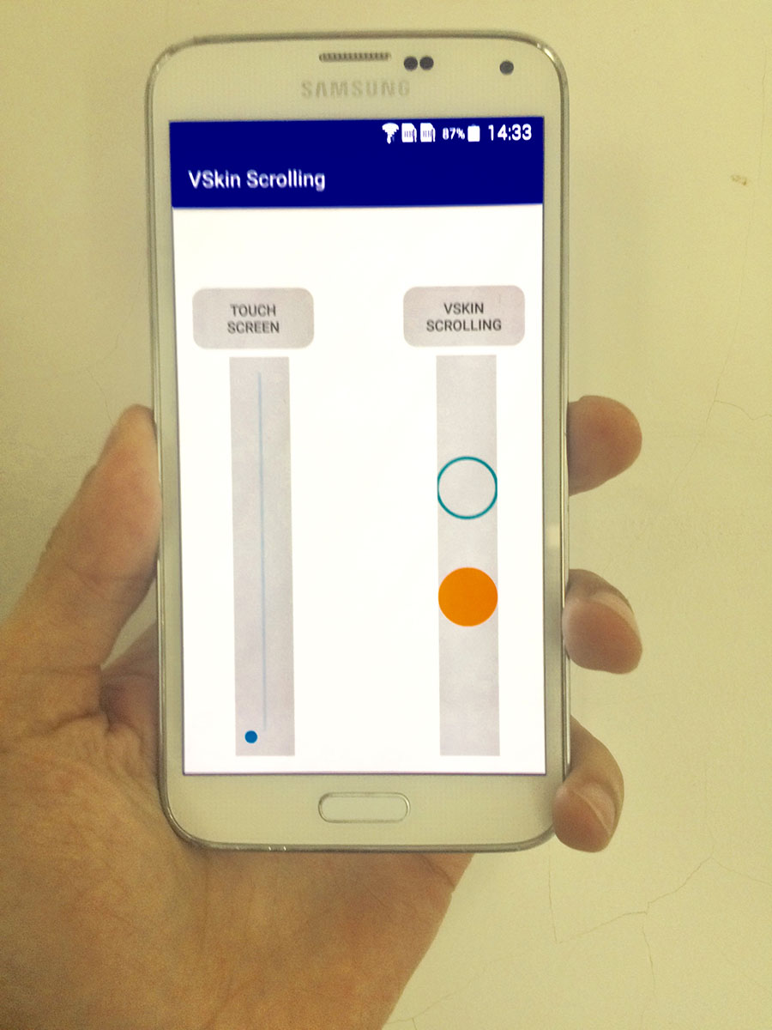
Case study: VSkinScrolling
Only 193.1ms slower than the touchscreen.

Slide 34
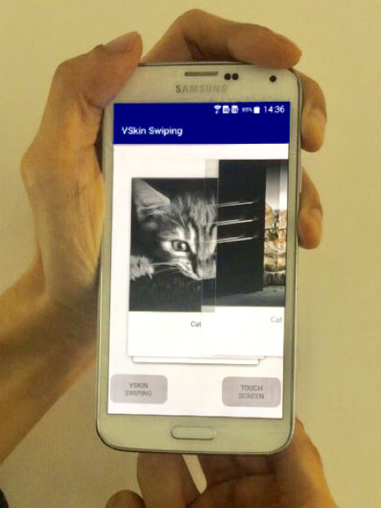
Case study: VSkinSwiping
Only 112.7ms slower than the screen
Direction recognition accuracy of 94.5%

Slide 35
Conclusion
Sensing touch gestures on all surfaces of mobile devices by separating the structure-borne and the air-borne sound signals.
Different kinds of touch gestures
swiping, tapping, scrolling
Fine-grained gesture measurement
mm-level distance accuracy, speed robustness
Low computational cost
real time APP works on mobile devices

Slide 36
Thank you
Q&A

